Slide 1

ICT Learning Centre @ UL - Python and ML Foundations
ML - Artificial Neural Networks

Slide 2


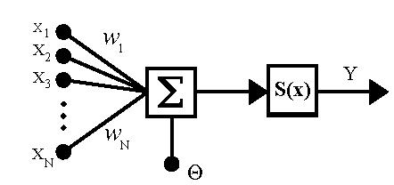
Perceptron
Building block of ANNs

Slide 3

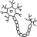


Perceptron Inspiration
Invented in the 1950s.

Slide 4
Working of a Perceptron
X1
X1
X2
X2
X3
X3
.
.
.
Xn
Xn

Slide 5
Working of a Perceptron
X1
W1
W1
W2
X2
W2
X3
W3
W3
.
.
.
Wn
Wn
Xn
X1
X2
X3
...
Xn

Slide 6

Working of a Perceptron
b
X1
W1
X2
W2
X3
W3
.
.
.
Wn
Xn
X1
W1
+
X2
W2
+
X3
W3
+
...
+
Xn
Wn
+
b

Slide 7

Working of a Perceptron
b
X1
W1
X2
W2
X3
W3
.
.
.
Wn
Xn
X1
W1
+
X2
W2
+
X3
W3
+
...
+
Xn
Wn
+
b

Slide 8
Working of a Perceptron
b
X1
W1
X2
W2
X3
W3
.
.
.
Wn
Xn
X1
W1
+
X2
W2
+
X3
W3
+
...
+
Xn
Wn
+
b

Slide 9
Working of a Perceptron
b
X1
W1
X2
W2
X3
W3
.
.
.
Wn
Xn
X1
W1
+
X2
W2
+
X3
W3
+
...
+
Xn
Wn
+
b

Slide 10

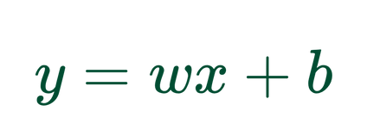

Linear regression
^
y
x

Slide 11
Working of a Perceptron
b
X1
W1
X2
W2
X3
W3
.
.
.
Wn
Xn
X1
W1
+
X2
W2
+
X3
W3
+
...
+
Xn
Wn
+
b

Slide 12
Working of a Perceptron
X0
1
b
b
X1
W1
X2
W2
z
X3
W3
.
.
.
Wn
Xn
z =
X1
W1
+
X2
W2
+
X3
W3
+
...
+
Xn
Wn
+
b

Slide 13


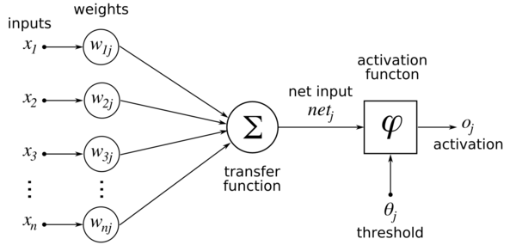
Working of a Perceptron
1
b
X1
W1
X2
W2
z
output
1
0
X3
W3
.
.
.
Wn
Xn
z =
X1
W1
+
X2
W2
+
X3
W3
+
...
+
Xn
Wn
+
b

Slide 14


Perceptron - linear classifier
1
y
b
X1
W1
X2
W2
output
X3
W3
.
.
.
Wn
Xn
x
z =
X1
W1
+
X2
W2
+
X3
W3
+
...
+
Xn
Wn
+
b

Slide 15

Case study: AND Gate
x1
y
x2

Slide 16
Case study: AND Gate
x1 | x2 | y
0 | 0 | 0
0 | 1 | 0
1 | 0 | 0
1 | 1 | 1
x1
y
x2

Slide 17
Case study: AND Gate
x1 | x2 | y
0 | 0 | 0
0 | 1 | 0
1 | 0 | 0
1 | 1 | 1
x1
y
x2

Slide 18
Case study: AND Gate
y
→ 0
→ 1
x1 | x2 | y
0 | 0 | 0
0 | 1 | 0
1 | 0 | 0
1 | 1 | 1
1
x
1

Slide 19

Case study: AND Gate
y
→ 0
→ 1
1
x1 | x2 | y
0 | 0 | 0
0 | 1 | 0
1 | 0 | 0
1 | 1 | 1
1
x
1
b
-3
W1
X1
2
W2
2
X2

Slide 20

Case study: AND Gate
1
-3
0
2
X1
2
0
X2
z = 0(2) + 0(2) +1(-3) = -3

Slide 21
Case study: AND Gate
1
-3
0
2
0
2
0
z = 0(2) + 0(2) +1(-3) = -3
→ 0

Slide 22
Case study: AND Gate
1
-3
0
2
X1
2
1
X2
z = 0(2) + 1(2) +1(-3) = -1

Slide 23
Case study: AND Gate
1
-3
0
2
0
2
1
z = 0(2) + 1(2) +1(-3) = -1
→ 0

Slide 24
Case study: AND Gate
1
-3
1
2
X1
2
0
X2
z = 1(2) + 0(2) +1(-3) = -1

Slide 25
Case study: AND Gate
1
-3
1
2
0
2
0
z = 1(2) + 0(2) +1(-3) = -1
→ 0

Slide 26
Case study: AND Gate
1
-3
1
2
X1
2
1
X2
z = 1(2) + 1(2) +1(-3) = 1

Slide 27
Case study: AND Gate
1
-3
1
2
1
2
1
z = 1(2) + 1(2) +1(-3) = 1
→ 1

Slide 28

Case study: OR Gate
y
→ 0
→ 1
x1 | x2 | y
0 | 0 | 0
0 | 1 | 1
1 | 0 | 1
1 | 1 | 1
1
x
1

Slide 29
Case study: OR Gate
1
-1
0
2
X1
2
0
X2
z = 0(2) + 0(2) +1(-1) = -1

Slide 30
Case study: OR Gate
1
-1
0
2
0
2
0
z = 0(2) + 0(2) +1(-1) = -1
→ 0

Slide 31
Case study: OR Gate
1
-1
0
2
X1
2
1
X2
z = 0(2) + 1(2) +1(-1) = 1

Slide 32
Case study: OR Gate
1
-1
0
2
1
2
1
z = 0(2) + 1(2) +1(-1) = 1
→ 1

Slide 33
Case study: OR Gate
1
-1
1
2
X1
2
0
X2
z = 1(2) + 0(2) +1(-1) = 1

Slide 34
Case study: OR Gate
1
-1
1
2
1
2
0
z = 1(2) + 0(2) +1(-1) = 1
→ 1

Slide 35
Case study: OR Gate
1
-1
1
2
X1
2
1
X2
z = 1(2) + 1(2) +1(-1) = 3

Slide 36
Case study: OR Gate
1
-1
1
2
1
2
1
z = 1(2) + 1(2) +1(-1) = 3
→ 1

Slide 37

Case study: XOR Gate
x1
y
x2

Slide 38
Case study: XOR Gate
x1 | x2 | y
0 | 0 | 0
0 | 1 | 1
1 | 0 | 1
1 | 1 | 0
x1
y
x2

Slide 39
Case study: XOR Gate
x1 | x2 | y
0 | 0 | 0
0 | 1 | 1
1 | 0 | 1
1 | 1 | 0
x1
y
x2

Slide 40
Case study: XOR Gate
x1 | x2 | y
0 | 0 | 0
0 | 1 | 1
1 | 0 | 1
1 | 1 | 0
x1
y
x2

Slide 41
Case study: XOR Gate
y
→ 0
→ 1
x1 | x2 | y
0 | 0 | 0
0 | 1 | 1
1 | 0 | 1
1 | 1 | 0
1
x
1

Slide 42

Case study: XOR Gate
y
→ 0
→ 1
1
x1 | x2 | y
0 | 0 | 0
0 | 1 | 1
1 | 0 | 1
1 | 1 | 0
1
x
1
b
X1
W1
W2
X2

Slide 43

Multi-layered Perceptron (MLP)
. . .
X1
. . .
X2
. . .

Slide 44

Solving the XOR Problem with MLP
y
→ 0
→ 1
. . .
X1
. . .
1
X2
. . .
1
x

Slide 45

Solving the XOR Problem with MLP
X1
X2

Slide 46
Solving the XOR Problem with MLP
1
1
-1.5
-0.5
-0.5
X1
1
1
-1
1
1
1
X2

Slide 47
Solving the XOR Problem with MLP
1
1
-1.5
-0.5
-0.5
X1
1
1
-1
1
1
1
X2

Slide 48
Solving the XOR Problem with MLP
z1 = 0(1) + 0(1) + 1(-1.5) = -1.5
=> h1 = 0
1
1
-1.5
-0.5
-0.5
0
1
1
-1
h1 = 0
1
1
1
0

Slide 49
Solving the XOR Problem with MLP
z1 = 0(1) + 0(1) + 1(-1.5) = -1.5
=> h1 = 0
1
1
-1.5
z2 = 0(1) + 0(1) + 1(-0.5) = -0.5
=> h2 = 0
-0.5
-0.5
0
1
1
-1
h1 = 0
1
1
1
0
h2 = 0

Slide 50
Solving the XOR Problem with MLP
z1 = 0(1) + 0(1) + 1(-1.5) = -1.5
=> h1 = 0
1
1
-1.5
z2 = 0(1) + 0(1) + 1(-0.5) = -0.5
=> h2 = 0
-0.5
-0.5
z3 = 0(-1) + 0(1) + 1(-0.5) = -0.5
=> hout = 0
0
1
1
-1
h1 = 0
0
1
1
1
hout
0
h2 = 0

Slide 51
Solving the XOR Problem with MLP
1
1
-1.5
-0.5
-0.5
X1
1
1
-1
1
1
1
X2

Slide 52
Solving the XOR Problem with MLP
z1 = 0(1) + 1(1) + 1(-1.5) = -0.5
=> h1 = 0
1
1
-1.5
-0.5
-0.5
0
1
1
-1
h1 = 0
1
1
1
1

Slide 53
Solving the XOR Problem with MLP
z1 = 0(1) + 1(1) + 1(-1.5) = -0.5
=> h1 = 0
1
1
-1.5
z2 = 0(1) + 1(1) + 1(-0.5) = 0.5
=> h2 = 1
-0.5
-0.5
0
1
1
-1
h1 = 0
1
1
1
0
h2 = 1

Slide 54
Solving the XOR Problem with MLP
z1 = 0(1) + 1(1) + 1(-1.5) = -0.5
=> h1 = 0
1
1
-1.5
z2 = 0(1) + 1(1) + 1(-0.5) = 0.5
=> h2 = 1
-0.5
-0.5
z3 = 0(-1) + 1(1) + 1(-0.5) = 0.5
=> hout = 1
0
1
1
-1
h1 = 0
1
1
1
1
hout
0
h2 = 0

Slide 55
Solving the XOR Problem with MLP
1
1
-1.5
-0.5
-0.5
X1
1
1
-1
1
1
1
X2

Slide 56
Solving the XOR Problem with MLP
z1 = 1(1) + 0(1) + 1(-1.5) = -0.5
=> h1 = 0
1
1
-1.5
z2 = 1(1) + 0(1) + 1(-0.5) = 0.5
=> h2 = 1
-0.5
-0.5
z3 = 0(-1) + 1(1) + 1(-0.5) = 0.5
=> hout = 1
1
1
1
-1
h1 = 0
1
1
1
1
hout
0
h2 = 1

Slide 57
Solving the XOR Problem with MLP
z1 = 1(1) + 1(1) + 1(-1.5) = 0.5
=> h1 = 1
1
1
-1.5
z2 = 1(1) + 1(1) + 1(-0.5) = 1.5
=> h2 = 1
-0.5
-0.5
z3 = 1(-1) + 1(1) + 1(-0.5) = -0.5
=> hout = 0
1
1
1
-1
h1 = 1
0
1
1
1
hout
1
h2 = 1

Slide 58
Solving the XOR Problem with MLP
1
1
-1.5
-0.5
-0.5
X1
1
1
-1
1
1
1
X2

Slide 59
Solving the XOR Problem with MLP
1
1
y
→ 0
→ 1
-1.5
-0.5
-0.5
X1
1
1
1
-1
1
x
1
1
1
X2

Slide 60
Solving the XOR Problem with MLP
1
1
-1.5
-0.5
-0.5
X1
1
1
-1
1
1
1
X2

Slide 61
Activation Functions
1
1
-1.5
-0.5
-0.5
X1
1
1
-1
1
1
1
X2

Slide 62

Activation Functions

Slide 63
Activation Functions

Slide 64
Activation Functions

Slide 65
MLP with Linear Activation Function

Slide 66
MLP with Linear Activation Function

Slide 67

MLP with Linear Activation Function

Slide 68
MLP with Linear Activation Function
?

Slide 69

MLP with Linear Activation Function

Slide 70
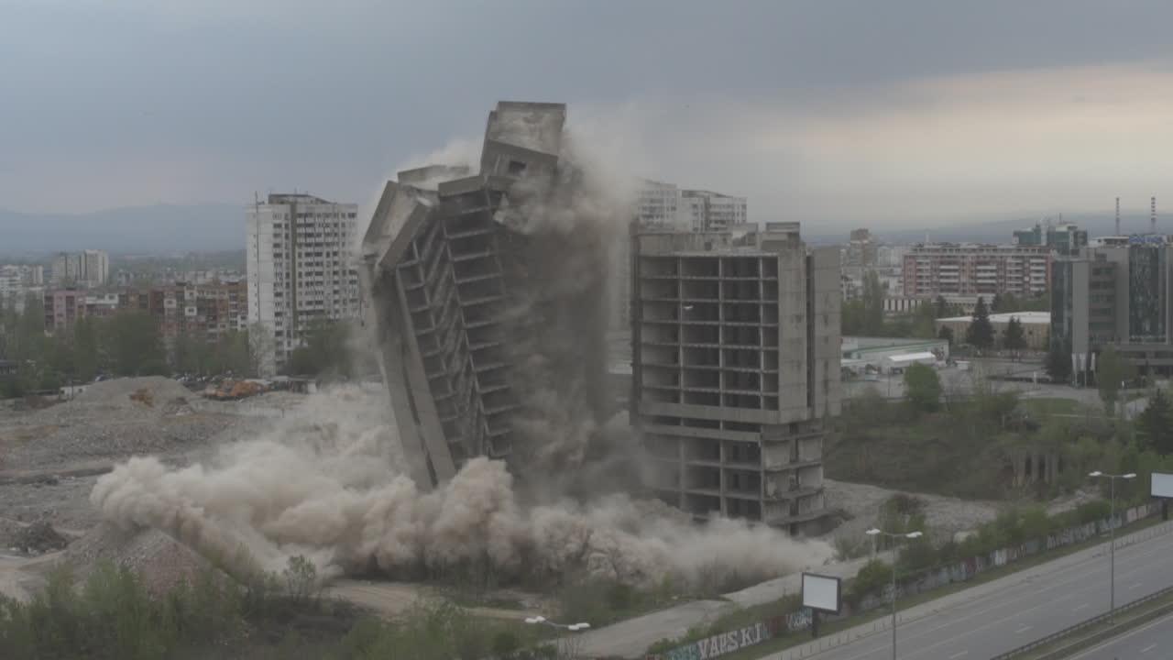

MLP with Linear Activation Function

Slide 71


MLP with Linear Activation Function

Slide 72
Non-linear Activation Function

Slide 73
Non-linear Activation Function

Slide 74
Solving the XOR Problem with MLP
1
1
-1.5
-0.5
-0.5
X1
1
1
-1
1
1
1
X2

Slide 75
Solving the XOR Problem with MLP
1
1
-1.5
-0.5
-0.5
0
1
1
-1
1
1
1
0

Slide 76
Solving the XOR Problem with MLP
1
1
-1.5
-0.5
-0.5
0
1
1
-1
h1 = 0
1
1
1
0

Slide 77
Solving the XOR Problem with MLP
1
1
-1.5
-0.5
-0.5
0
1
1
-1
h1 = 0
0
1
1
1
hout
0
h2 = 0

Slide 78
Threshold function - downside

Slide 79
Threshold function - downside
y
1
x

Slide 80

Better Non-linear Activation Function
y
1
0.5
x

Slide 81
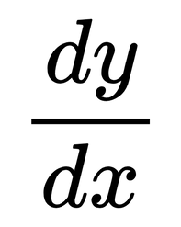
Better Non-linear Activation Function
y
1
0.5
x

Slide 82

ICT Learning Centre,
CS1-046,
CSIS Building,
University of Limerick,
http://ictlc.ul.ie/contactus
Thank you

